Slide 1
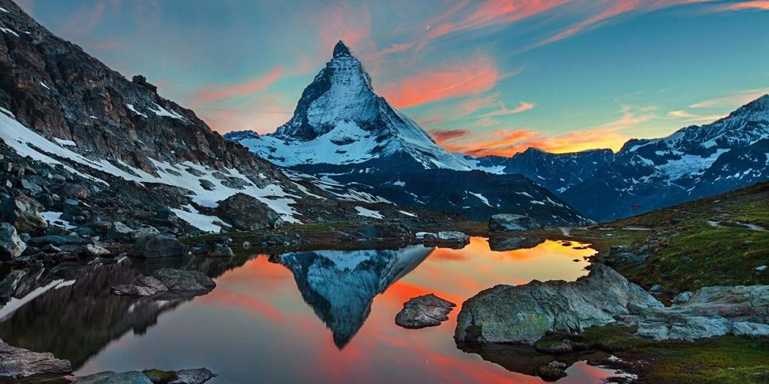

Information Pack
Peak

Slide 2
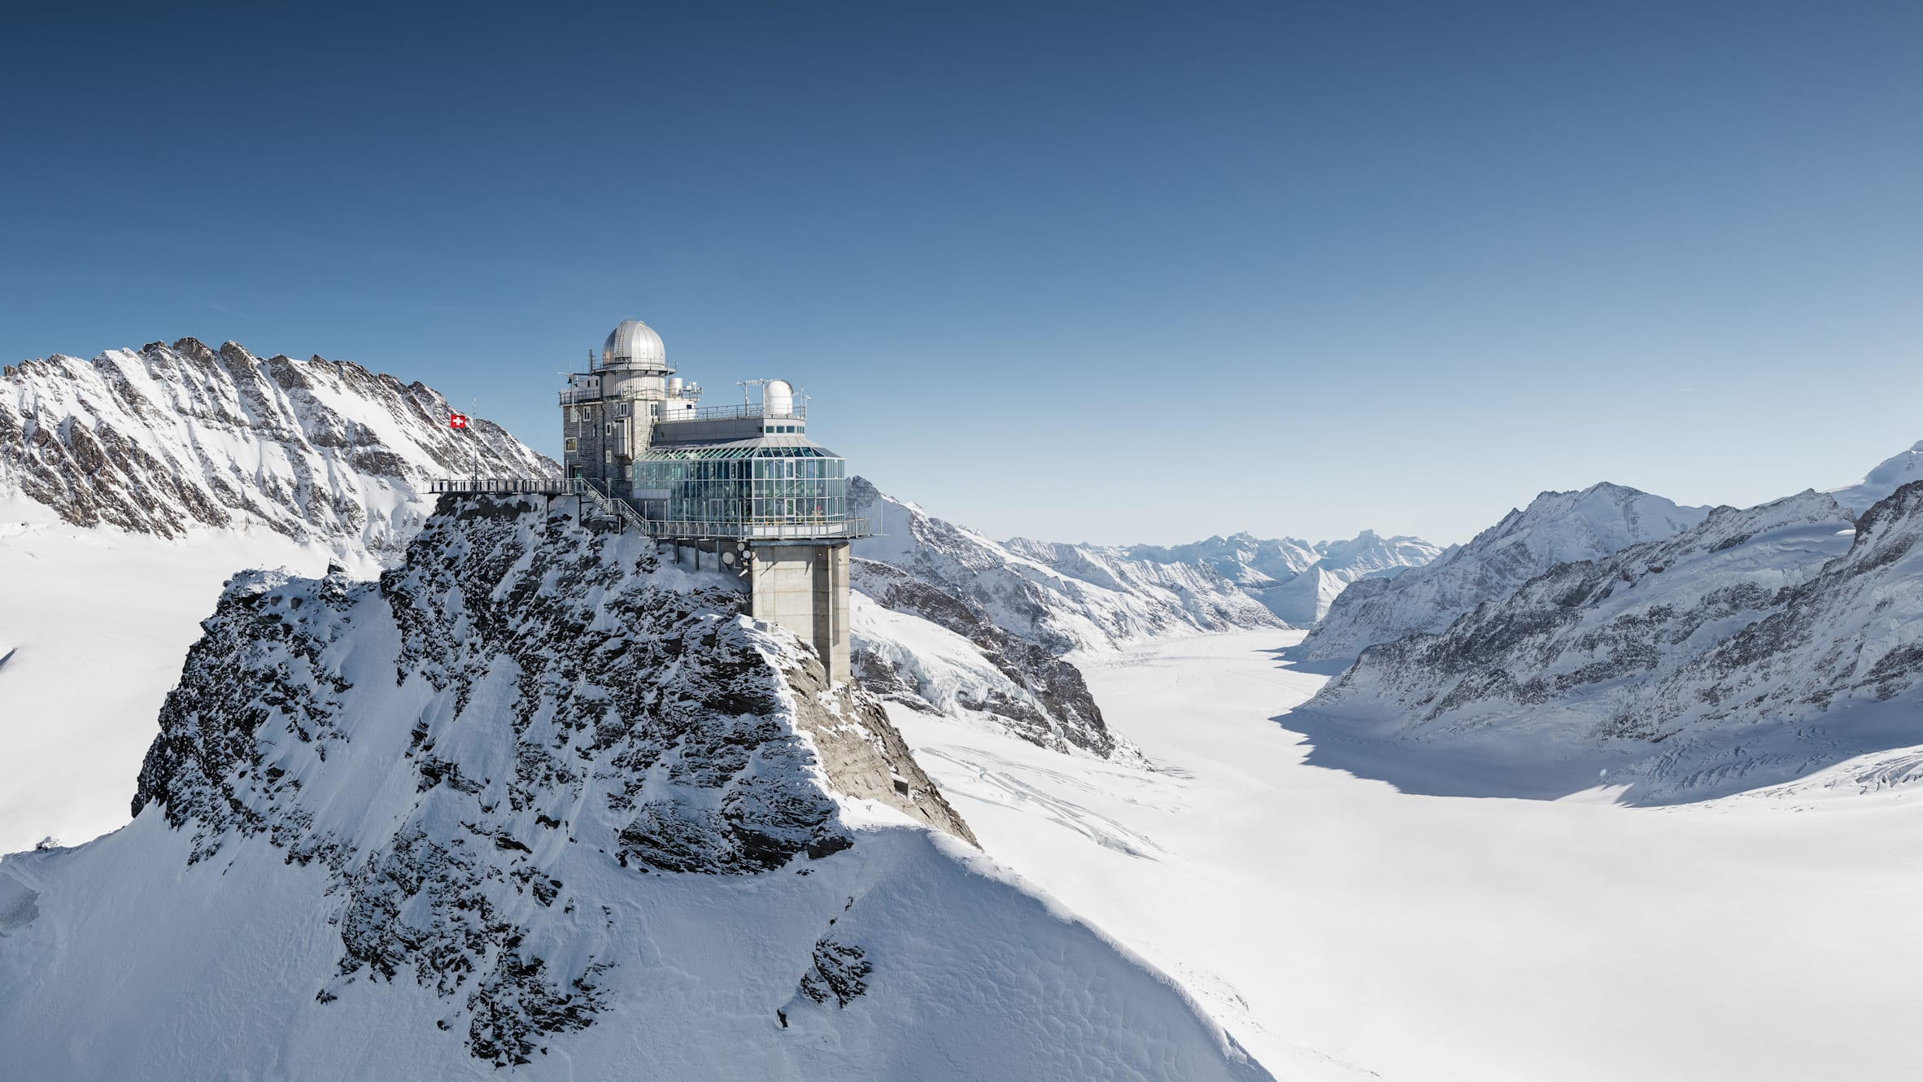
Introduction

Slide 3
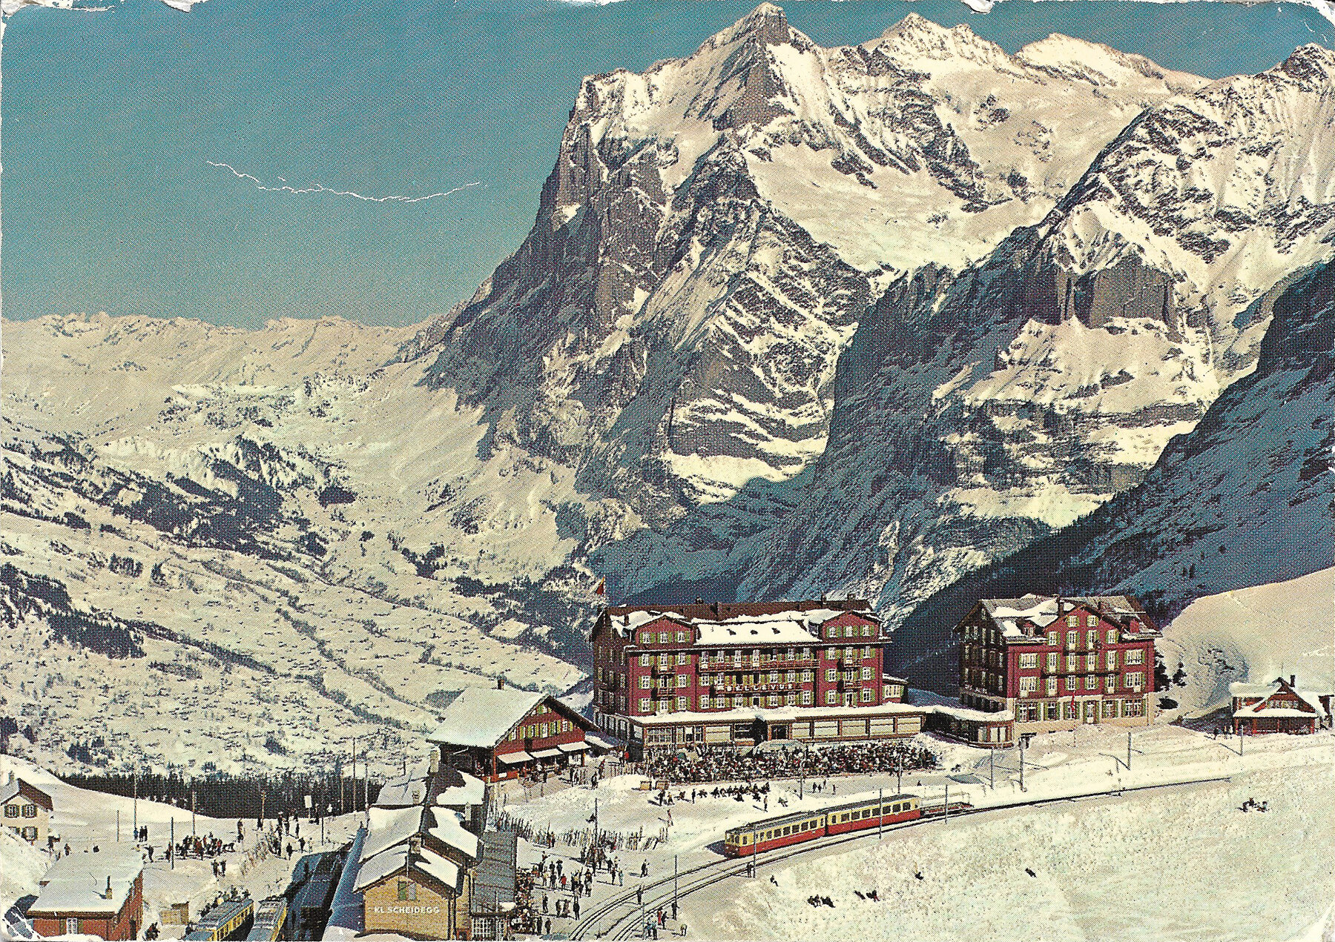
Historical significance of the Swiss alps
The Swiss Alps have long been a sanctuary generations of thinkers, offering a retreat for deep thinking, reflection and creativity. The majestic landscapes has inspired countless individuals to achieve their greatest work.
Friedrich Nietzsche found profound philosophical clarity in Sils Maria, where he explored the depths of human existence.
Albert Einstein’s retreats to the Swiss Alps allowed him to relax and think deeply, contributing to his theories of relativity that revolutionized modern physics.
Richard Wagner composed some of his greatest works, drawing inspiration from the alpine scenery, while residing in Luzern.
At Peak, we aim to reinvent this old practice by providing modern, immersive retreats in the Swiss Alps, fostering creativity, strategic thinking, and innovation in the tranquil and inspiring environment that has guided some of history’s greatest minds.

Slide 4
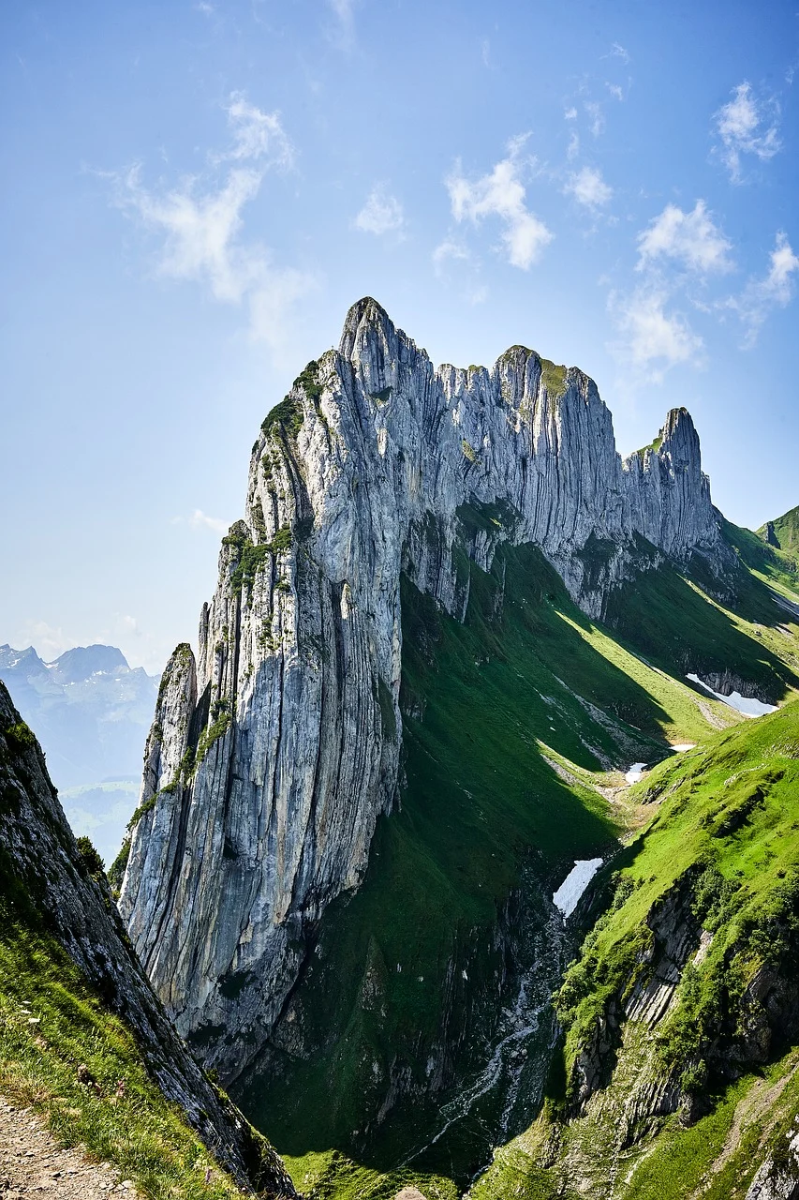
Our vision
We are dedicated to helping leadership overcome their toughest challenges, seize their greatest opportunities, and make critical decisions with confidence through executive retreats in the Swiss Alps.
Reviving the practise of these retreats used by renowned thinkers to create the perfect mental states to enhance creativity, trigger non linear ideation and unlock innovative thinking while providing all the necessary insights and facts to make informed decisions.
We look to depart from outsourced thinking of traditional consulting and rather focus on uplifting and supporting you to develop comprehensive solutions with us tailored to your needs.

Slide 5
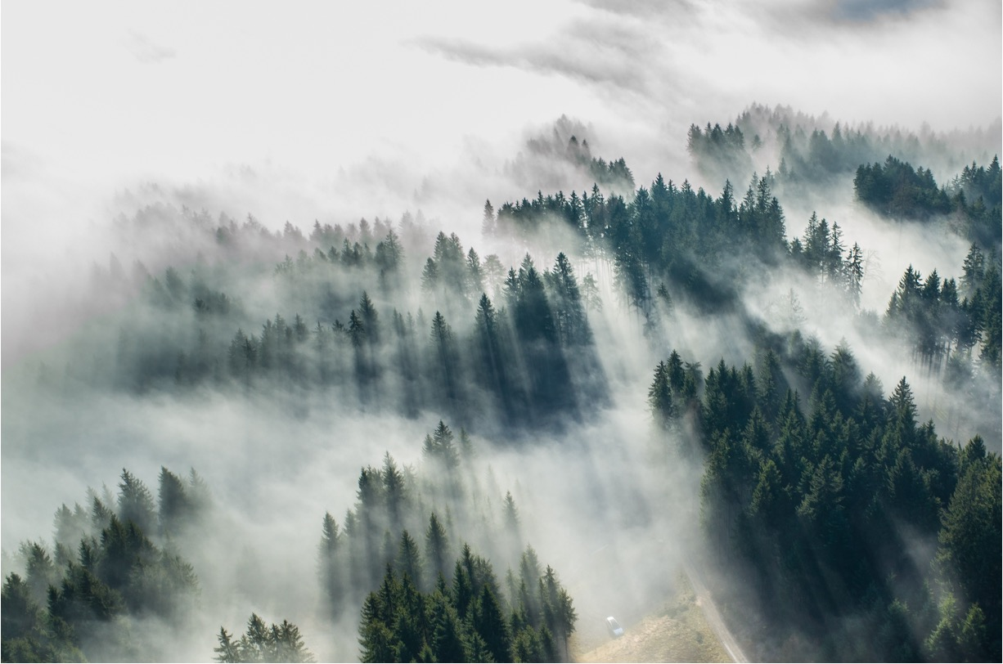



Why choose Peak
Empowered decision making
We reject the typical consulting approach of complete outsourced thinking. Instead, we focus on empowering you with everything you need to make key decisions
Cost concious consulting
Benefit from our use of in-house and specifically sourced expertise, ensuring value without unnecessary premium costs of typical consulting
Focused tailored retreats
Experience an isolated, curated, and in-person retreat designed to solve the key issue at hand. Every retreat is customized to meet your unique business needs and preferences maximizing the impact

Slide 6
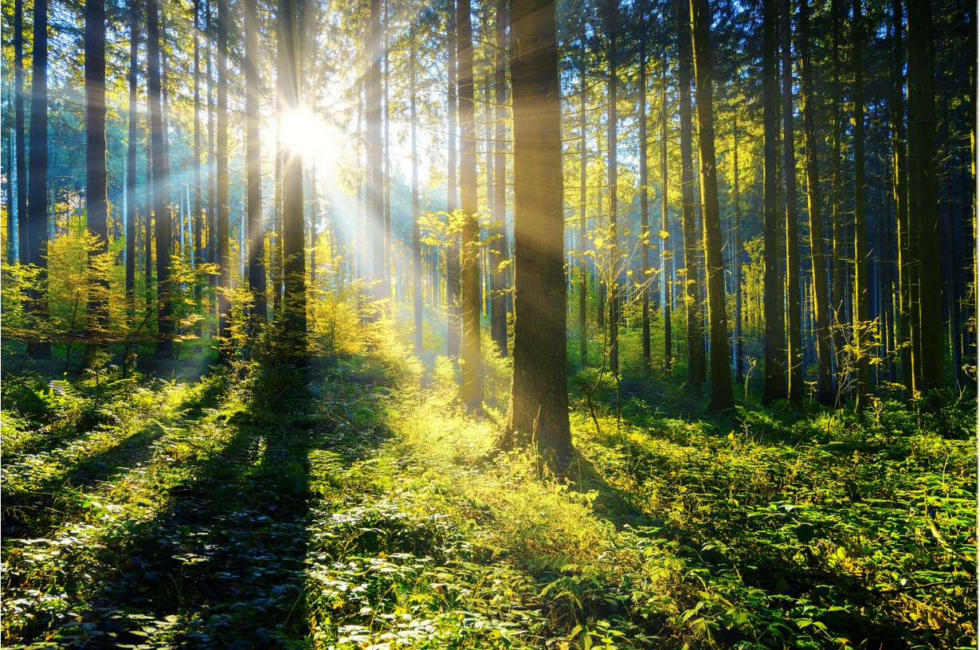



What makes us unique
Thinking space
We focus on placing you in the optimal environment with the right time and cognitive capacity to enable non-linear thinking and free up mental capacity needed to make big decisions
Decision support
We deliver precise and actionable insights & research while finding you the appropriate experts to provide all required facts to enable informed decisions
Holistic approach
The distinctive blend of guided thinking, creative processes, and analytical elements in our retreats fosters a truly comprehensive approach to consulting

Slide 7
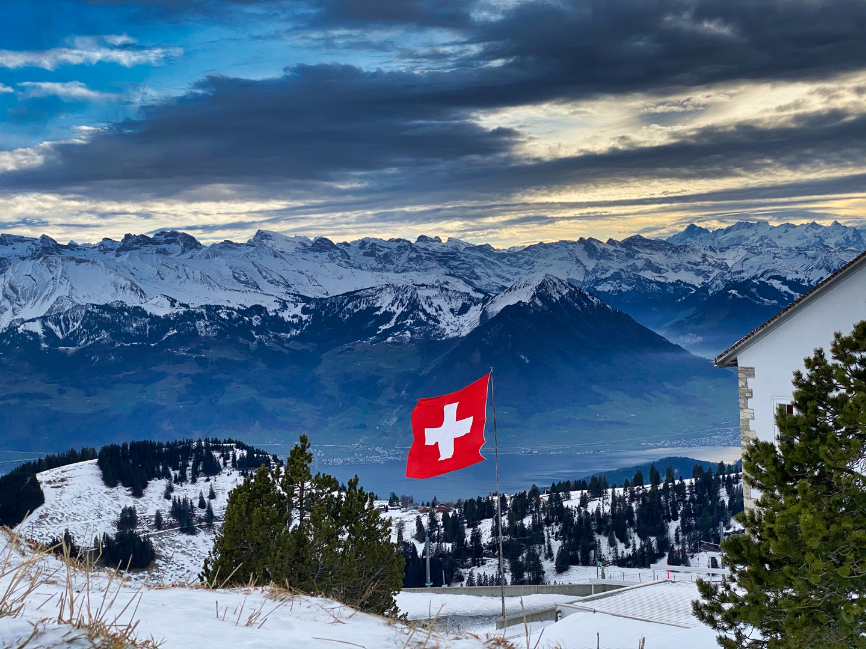
Thinking space

Slide 8
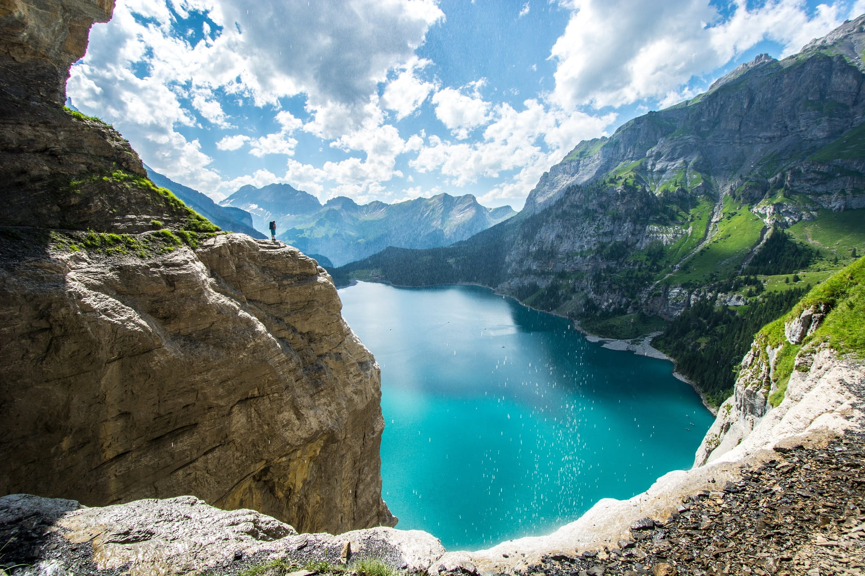
Focus on the mental state
The quality of our thinking and problem-solving is significantly influenced by our mental state and environment.
Traditional office settings, often filled with interruptions, stress, and constant demands, are not conducive to achieving the right mental state needed for deep reflection and innovative thinking.
This ideal mental state is characterized by clarity of thought, relaxed focus, creativity, and non-linear thinking, free from stress. Achieving this mental state is crucial for utilize full cognitive capabilities and bandwidth.
Peak’s approach aims to create an environment that consistently fosters and enhances this ideal mental state, promoting the highest level of thinking. This helps to eliminate hasty decisions and impulsive reactions typical of traditional office decision-making processes.

Slide 9
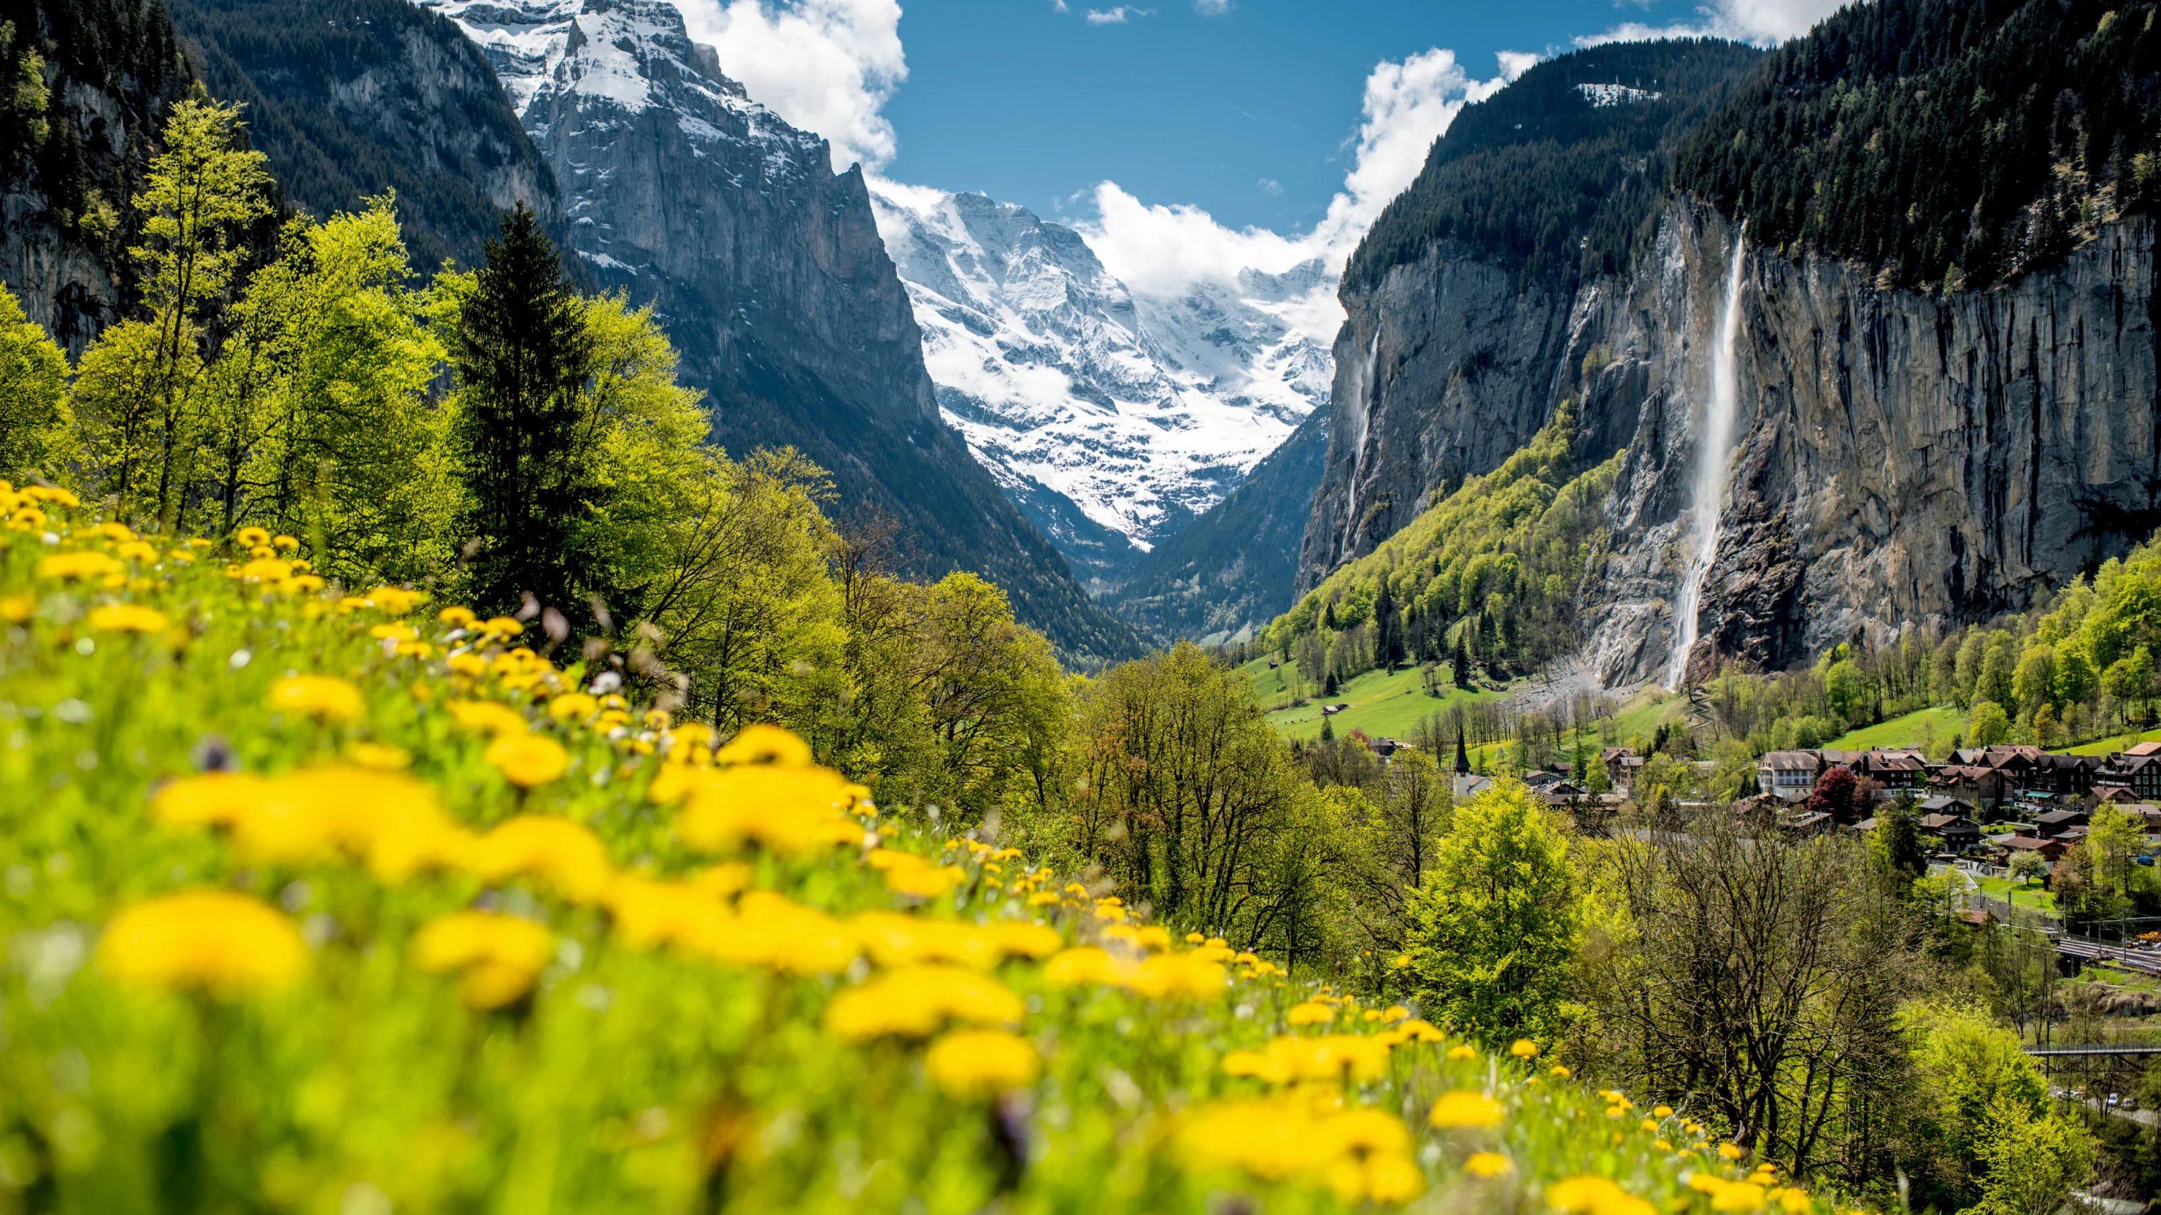



best environment for thinking
Location
Set in the Swiss Alps, the location is selected based on your preferences from a range of nature or luxury-inspired settings, tailored to the desired mood of the retreat
Isolation
The offsite is designed to ensure isolation, minimizing external disturbances which helps maintain the focus and stress-free environment for effective decision-making
Adventure
Every retreat includes a range of activities tailored to your preferences to help attendees relax, reinvigorate and re-energize their minds and bodies

Slide 10
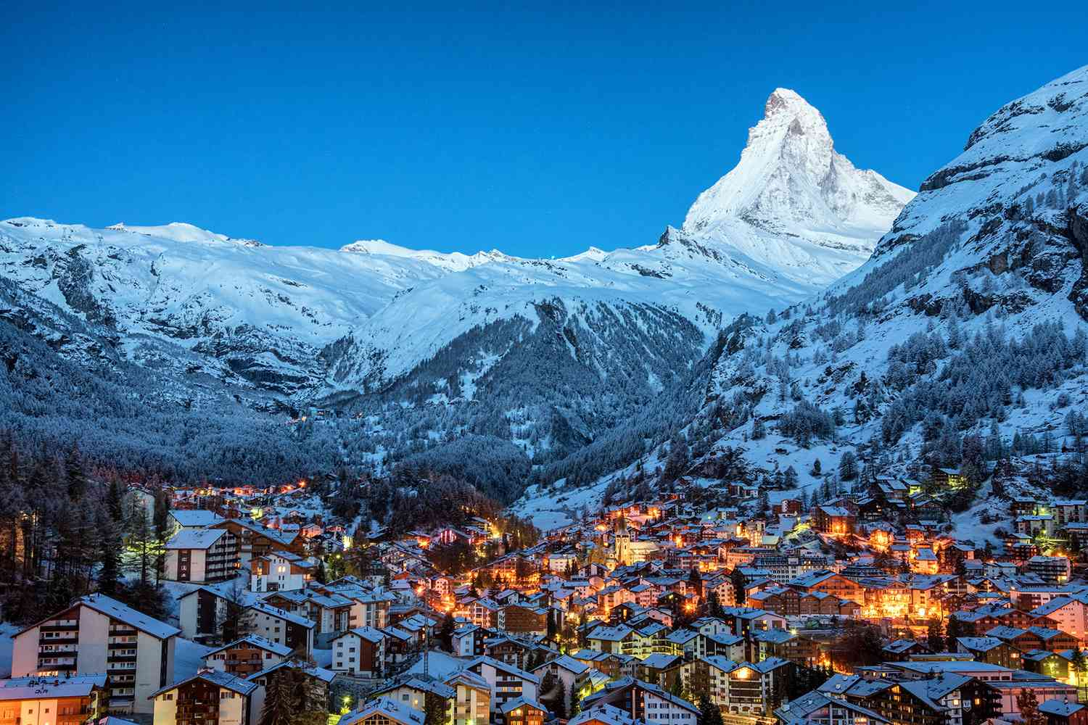


locations
Nature
Explore picturesque Alpine towns renowned for their tranquil, inspiring, and secluded ambiance. Envision charming chalets and high-end hotels nestled amidst breathtaking natural landscapes. These quaint alpine retreats prioritize serene settings and nature-based activities
Luxury
Indulge in the timeless allure of historical luxury Swiss towns, where every corner is adorned with majestic architecture and centuries-old landmarks, each telling a story of grandeur and prestige. Immerse yourself in the rich cultural heritage while enjoying the finest amenities and hospitality
Find our list of luxury and nature locations here : Google Earth

Slide 11
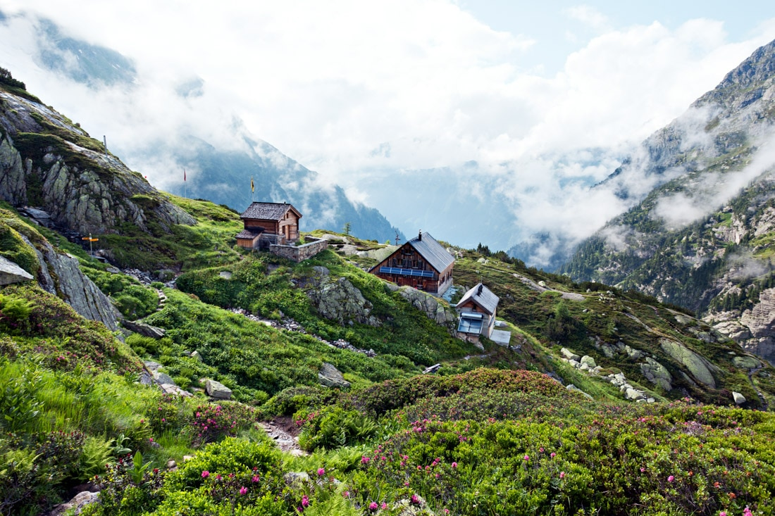
Isolation
Shielding oneself from everyday distractions and problems is often overlooked by many leaders in companies. When leaders are overwhelmed by the operational stresses and major issues, their cognitive abilities are compromised.
This diminishes their capacity to think critically and creatively, leading to a tendency to opt for short-term or conventional solutions rather than dedicating the necessary attention and focus required for comprehensive problem-solving. Consequently, this approach can result in unresolved mid to long-term issues due to inadequately developed solutions.
By deliberately stepping away from familiar surroundings and shielding oneself from daily stresses, one can optimize their cognitive capabilities and bandwidth. This optimal state allows leaders to fully engage with and effectively address the challenges they face in a thoughtful and strategic manner.

Slide 12
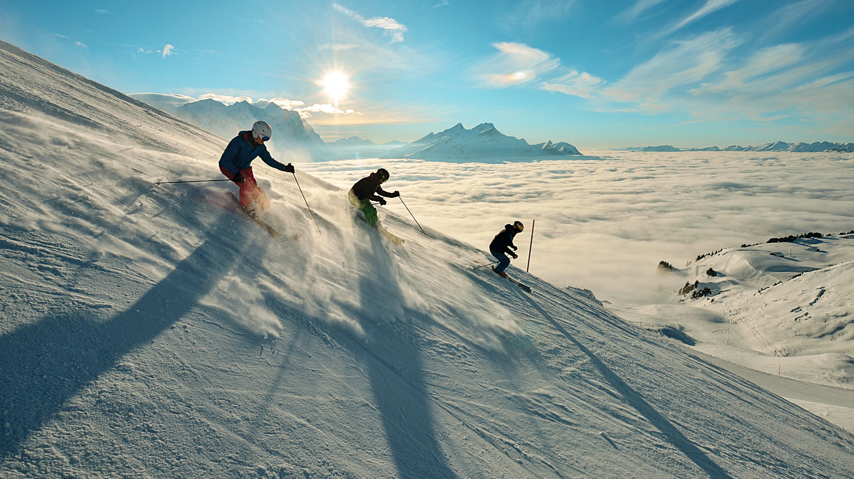



Adventure
Excite
Experience the thrill of winter with exhilarating alpine sports like skiing and snowboarding, or embrace the summer months with activities such as golfing, mountain biking, paragliding, and more. The choice is yours to invigorate both body and mind amidst the stunning Swiss scenery
Peace
Embrace tranquillity through calming activities such as hiking, sightseeing, e-biking tours, cloud watching, and more. Let the majestic Alpine views rejuvenate and refresh your mind
Relax
Indulge in serenity and clarity of mind with bespoke spa experiences boasting exquisite views of the Alps. Let the tranquil surroundings inspire your thoughts and soothe your body, as you unwind amidst the breathtaking scenery

Slide 13
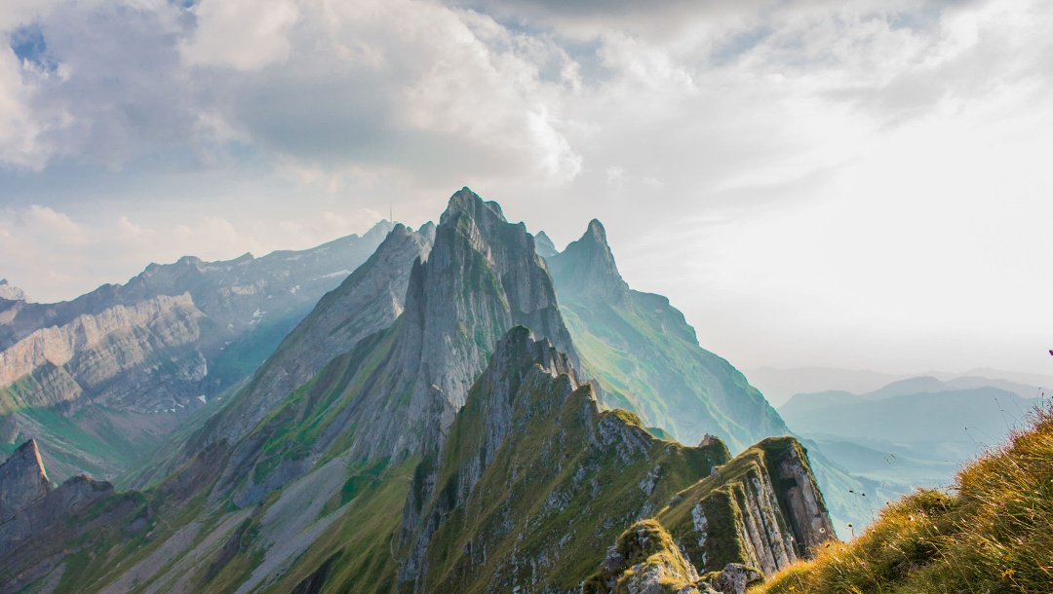
Decision support

Slide 14
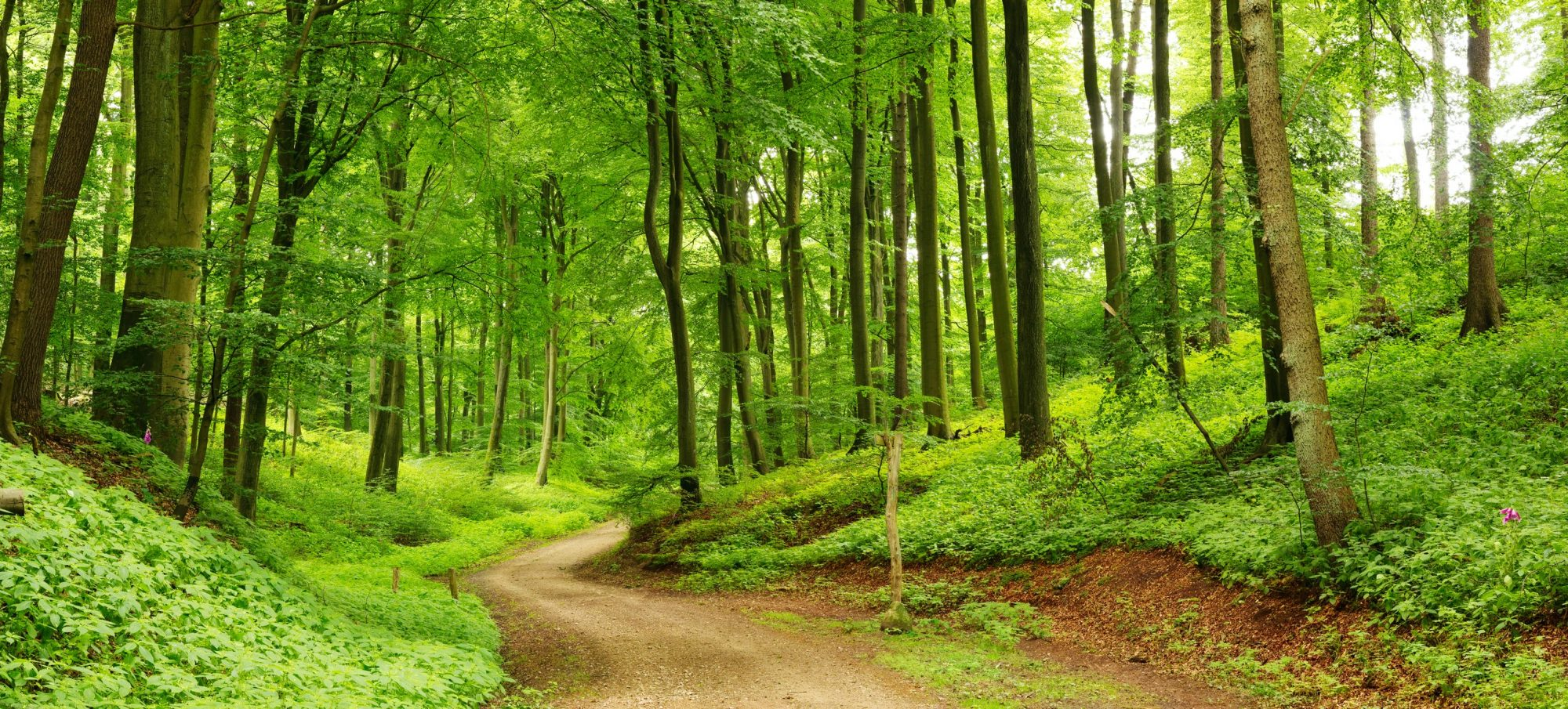



Providing the right support
Expertise
Access new insights and innovative perspectives from top industry experts. We source the best minds both in-house and externally to tailor their expertise to your specific requirements
Data driven insights
Take advantage of our bespoke analytics services to deeply analyze your data, uncover critical insights, and identify key trends that are essential for making informed decisions
Meditation
Our guided thinking, creative frameworks, and mediated sessions focus discussions and ideas directly on the problem space, ensuring comprehensive and fully developed solutions

Slide 15
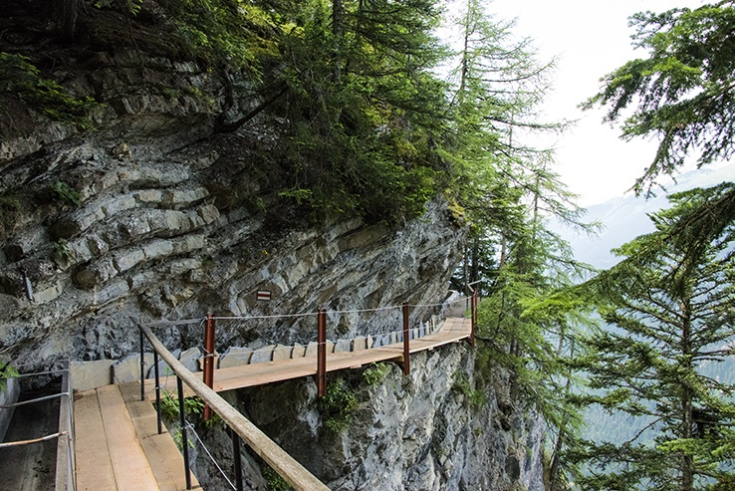


Finding the right Expertise
In-house expertise
We boast a comprehensive global network of experts specializing in key industries and technologies. These unbiased experts provide valuable insights to guide your decision-making
External expertise
If your needs are more niche and nuanced, we will search for and find the right experts to address them. These external experts will be thoroughly vetted before being presented for your approval

Slide 16
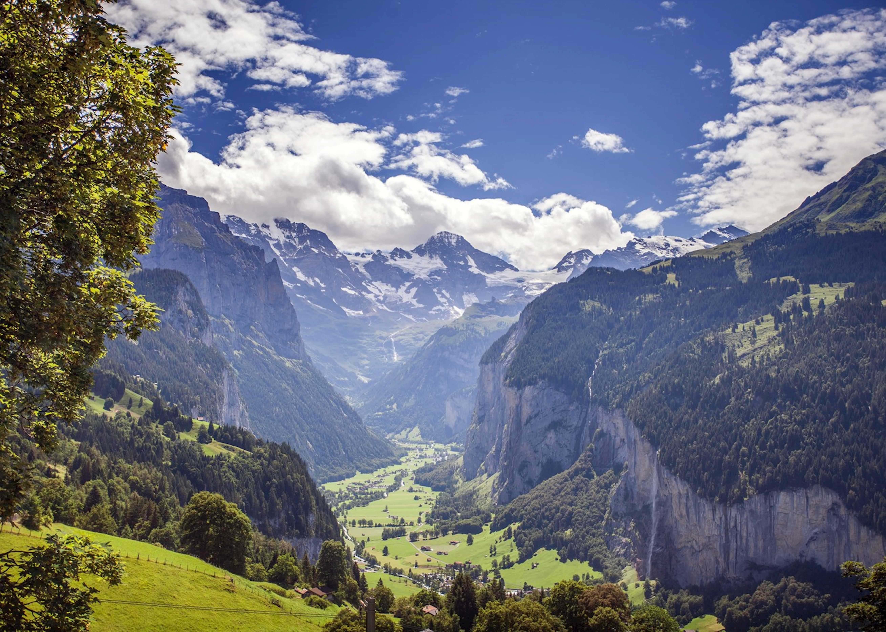



Data driven insights
Behavioural analytics
Gain deep insights into the diverse behavioural patterns of customers, products, and divisions. Uncover key insights and identify profitable trigger points to leverage for maximum impact.
Prevenue, profit & cost analytics
Understand the key drivers of revenue, profit, and costs at both the top and bottom levels. Utilize these insights to make data-driven strategic and tactical decisions
Custom advanced analytics
We employ a broad array of advanced techniques to interpret and deeply analyze your unique datasets. This enables us to uncover critical insights and address key issues effectively

Slide 17
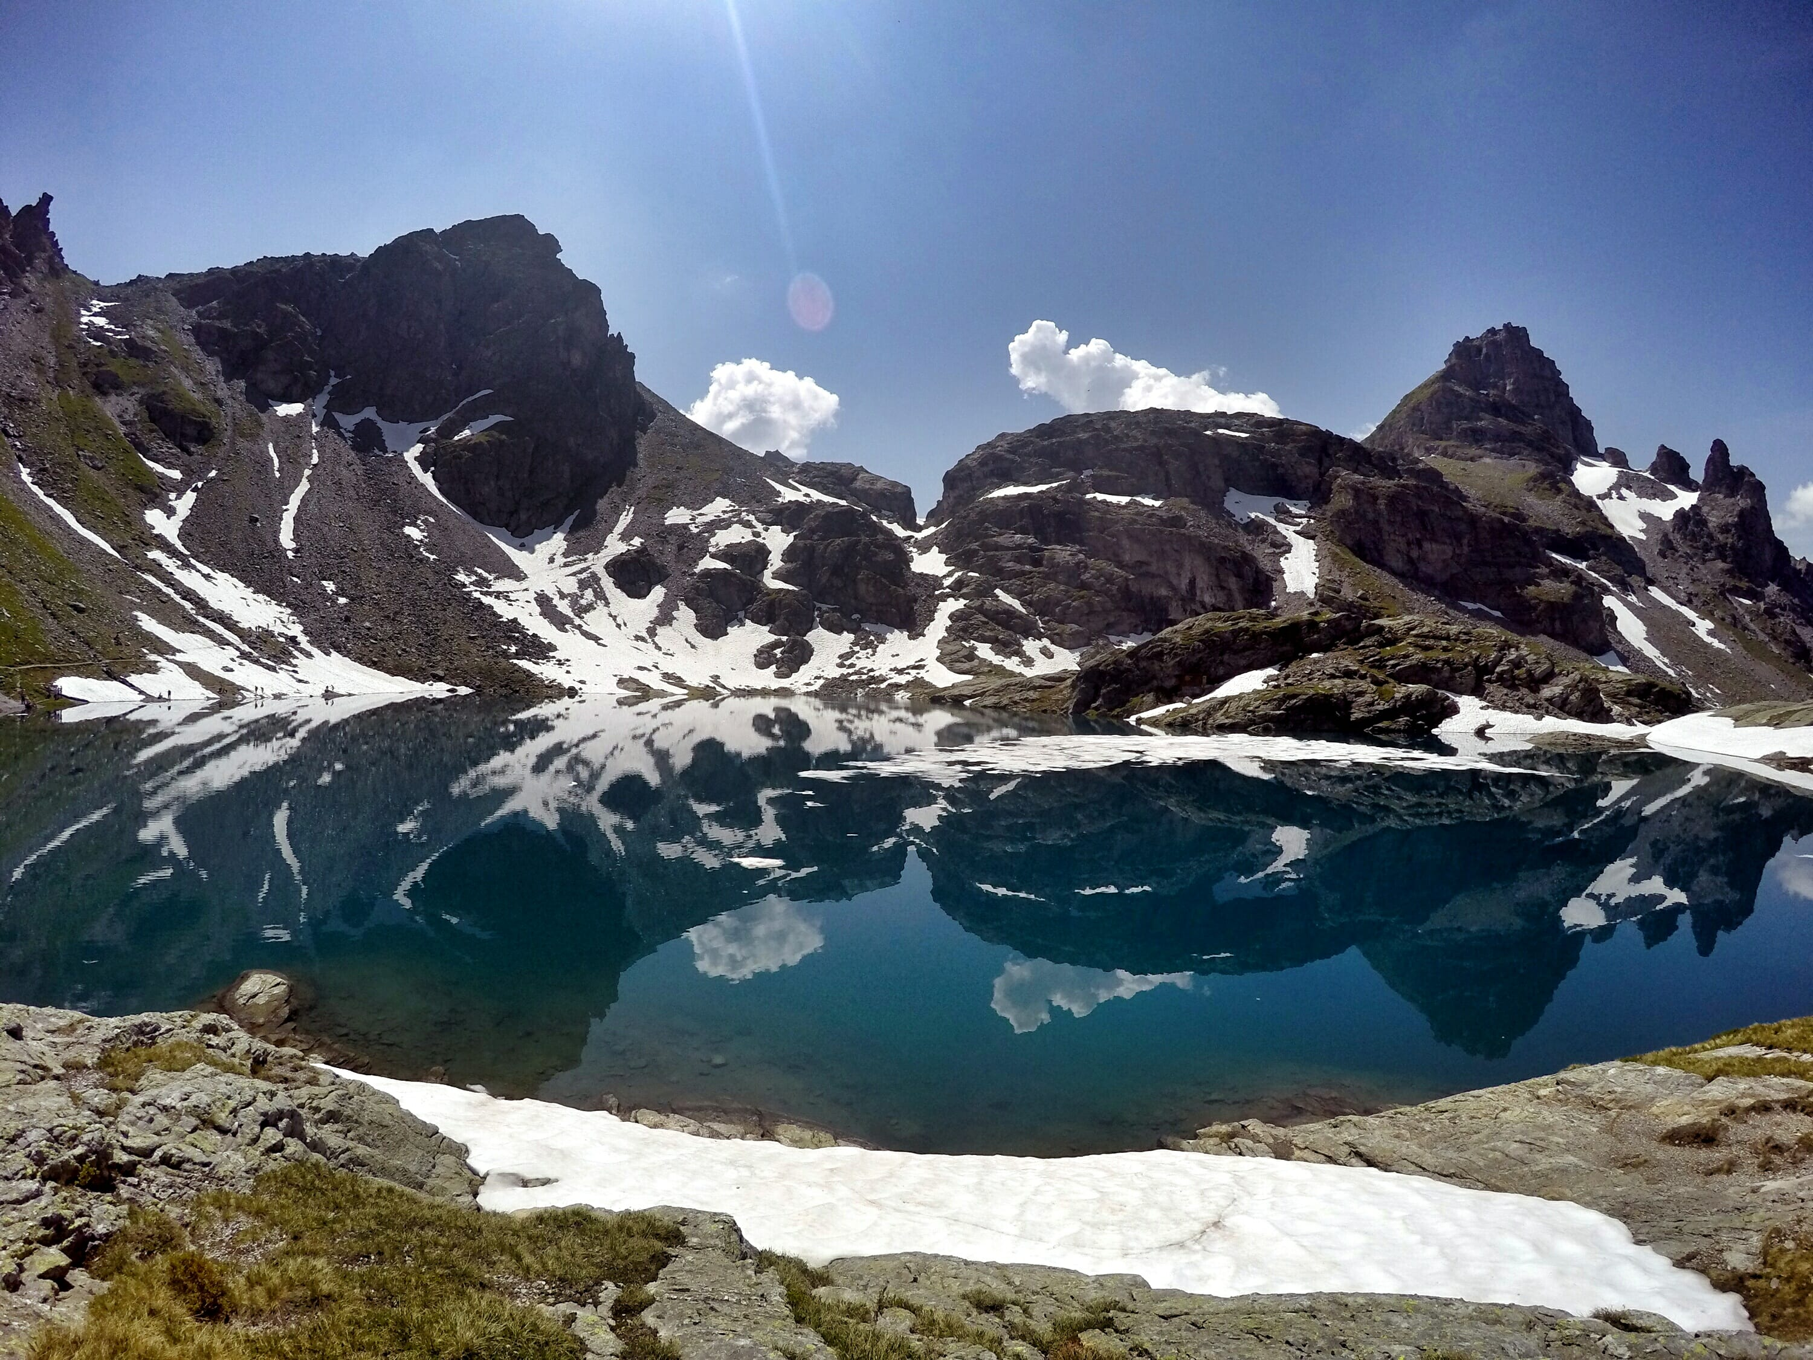



Mediation
Innovation process
We offer a robust and adaptable methodology that guides you through every stage of the thinking process. From conceptualization, brainstorming to final solution development, we help you discover truly innovative solutions
Guided thinking
We journey with you from start to finish by providing guidance, maintaining focus on the core issues and infuses creativity into the process, ensuring the best thinking from you & your team
Creative solutioning
We pride ourselves on helping clients uncover non-linear approaches to viewing their business challenges. Our methods foster innovative thinking, allowing you to see your business from new and unique angles

Slide 18
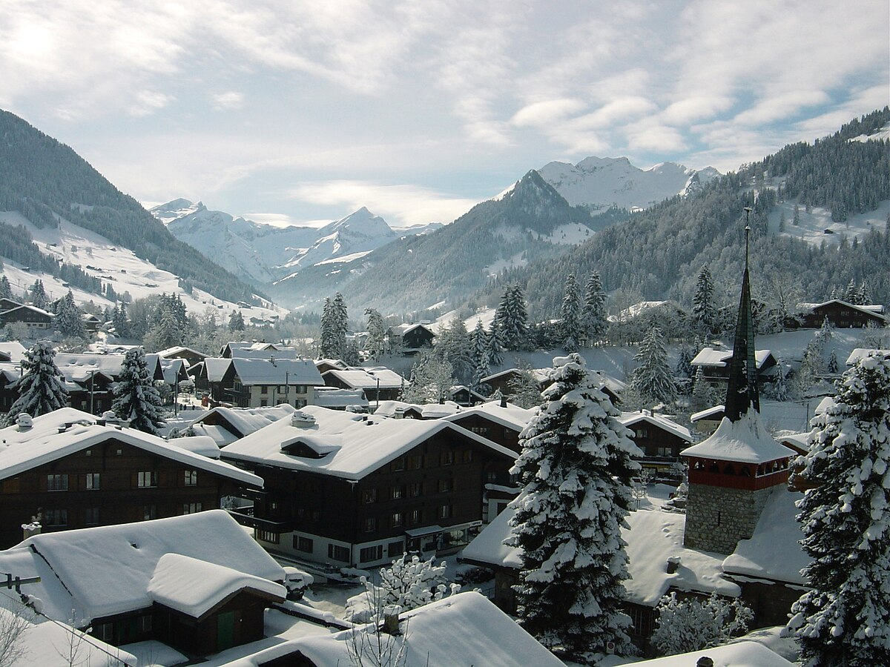
The process

Slide 19



The process
3-5 days
1-3 months
1-2 weeks
Pre-Retreat
Retreat
Post-Retreat
Working together to identify the topic while we organize the support and retreat
Engage in a multi-day journey to brainstorm, innovate, and develop solutions for your topic
The results of the retreat are Summarized, compiled and delivered

Slide 20
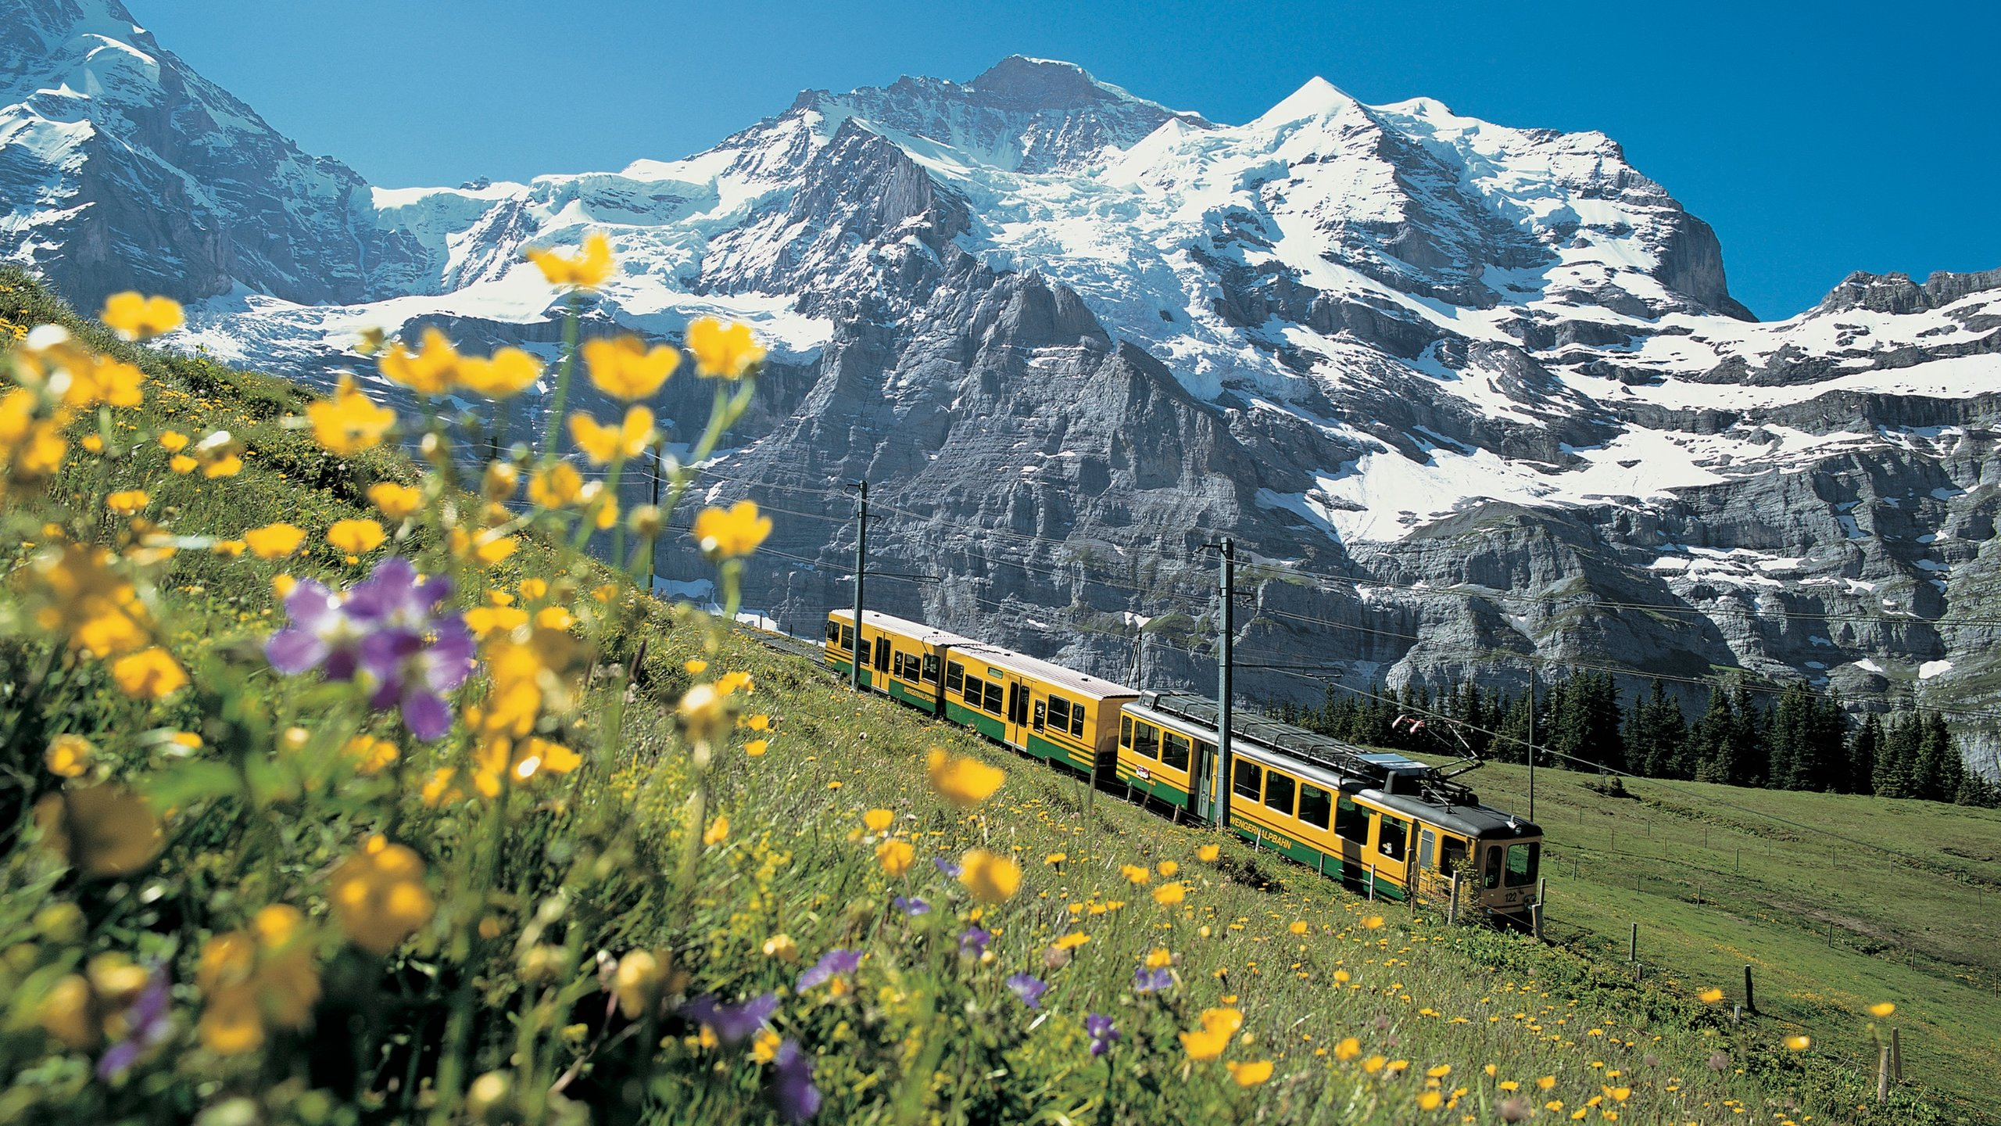




Pre-retreat
Selection of the topic
We will explore your different challenges, problems, or decisions that require the retreat’s focus
Data & research preparation
Once the main topic is selected, we will prepare data requests and analyze the data to generate insights. External research will be conducted as needed, with outputs aligned and updated throughout the process
Expert search and vetting
We will identify and vet the right experts from within our network or externally, ensuring their expertise matches your needs before seeking your approval
Retreat planning
We will handle all logistics & planning, including flights, transportation, location, activities, and the daily schedule. Everything will be proposed and booked once approved by you

Slide 21
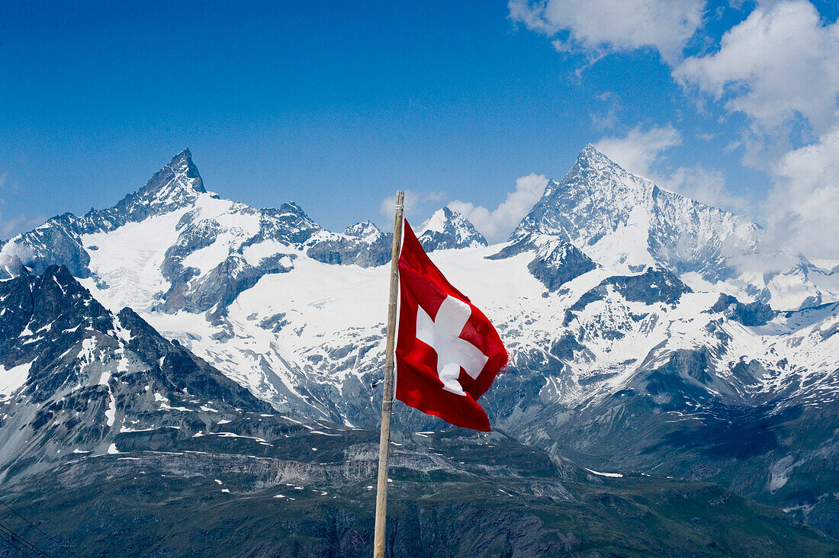



retreat
Landing & pickup
As soon as you land in Switzerland, you will be in our care. Arrival and transport to the offsite location will occur the day before the retreat occurs
Experience
The full retreat will be curated by our team and include a dynamic itnerary based on the progress, direction and energy of you and the team. Set times for personal and business connection are built in
Send off & post retreat planning
We will facilitate your transit and departure. If you want to spend time after the retreat exploring Switzerland, we offer leisure and travel advice and if needed bookings and planning

Slide 22
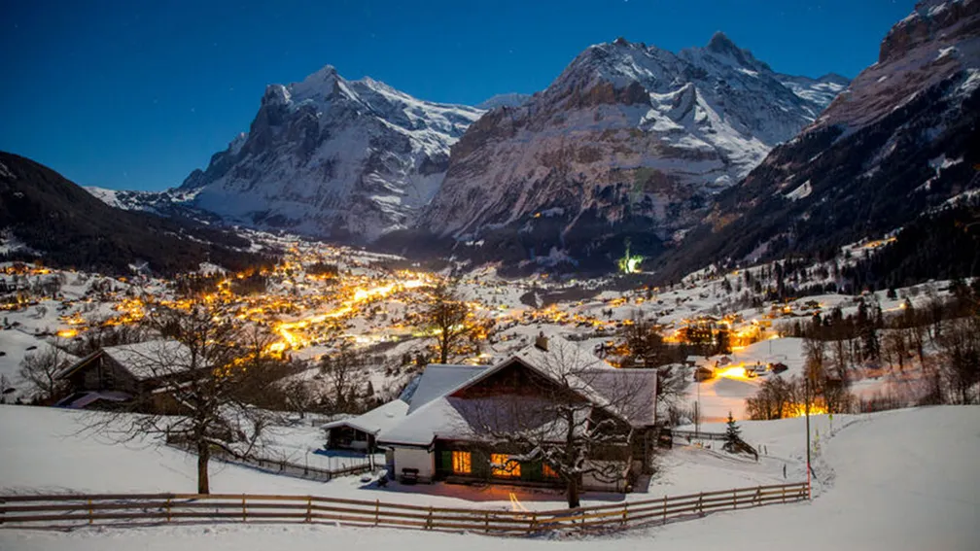



Post-retreat
Summarization of retreat
We will compile the entire output of the retreat into a comprehensive report, detailing key decisions, recommendations, and next steps. All insights and decision support will be included
Implementation recommendation
We can assist in referring or vetting implementation partners for your recommendations. Our commitment is to help make the decisions from the retreat a reality
Handover
Any analytics, insights, or research artifacts like code or dashboards will be handed over and integrated into your organization by your team members

Slide 23
Pricing & contact

Slide 24
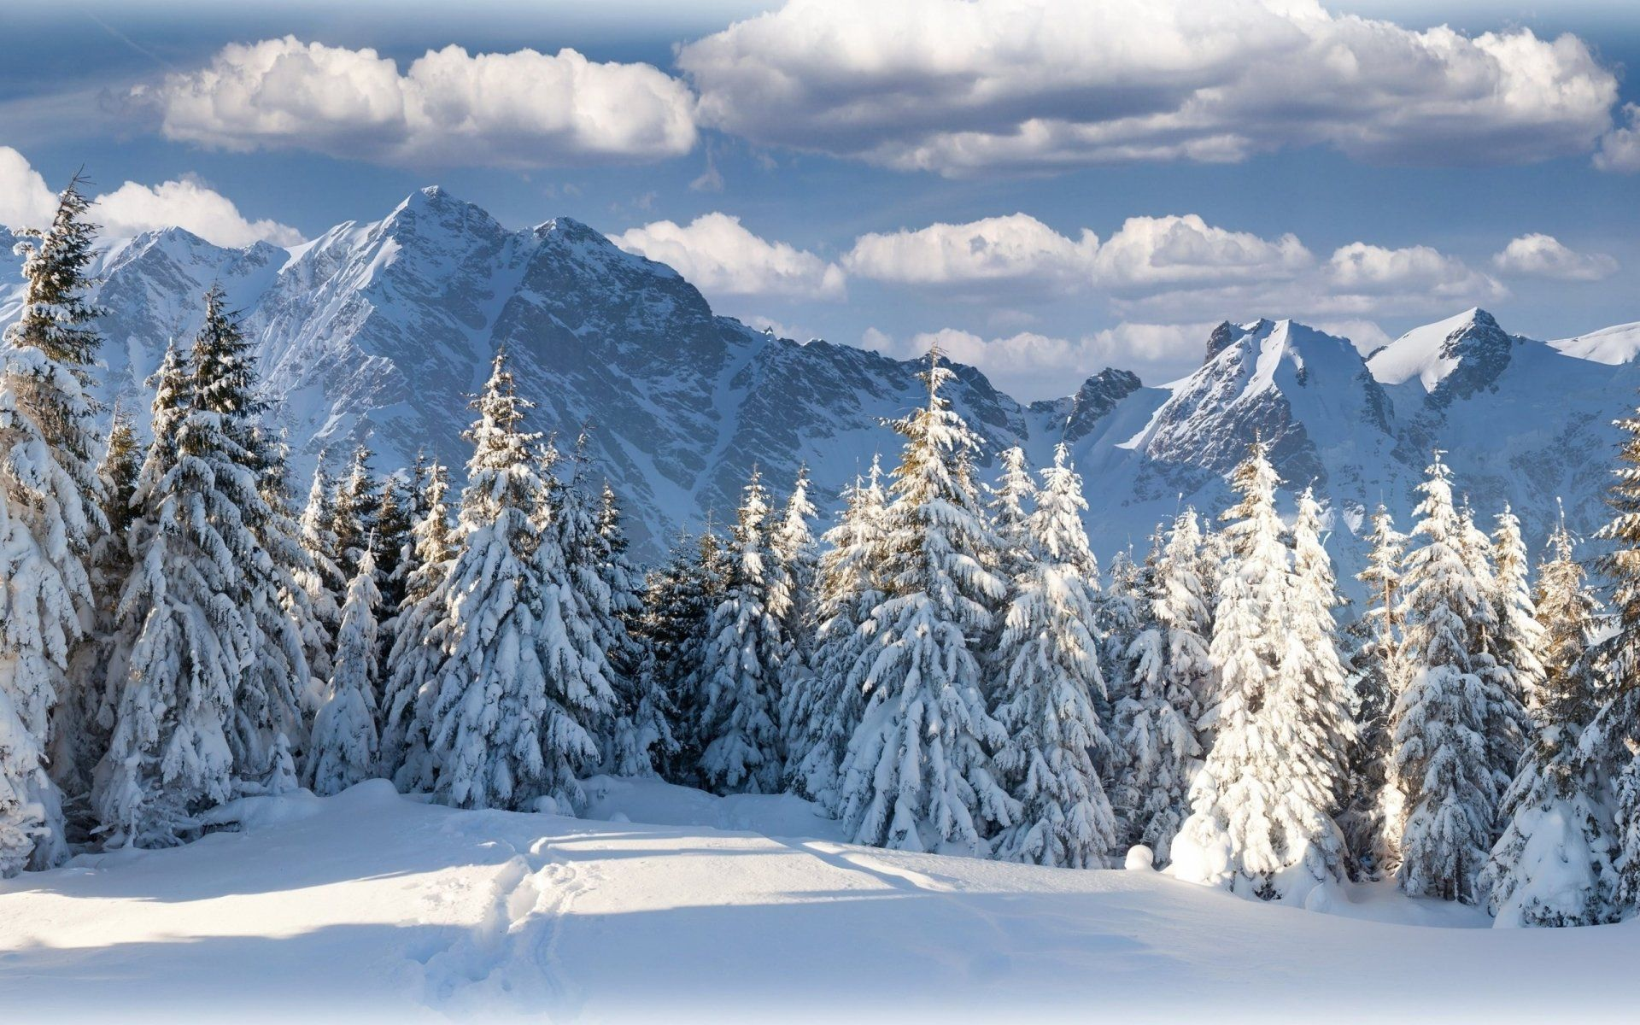
Pricing
Approximate split of total cost
Pre-retreat costs
Research hours
Analytics hours
~60%
Retreat costs
In person mediation & curation hours
Retreat components (flights, transit, hotel, F&B, activities)
Retreat planning (15% of the cost of the retreat components)
Expert hours
Expert planning (15% of the cost of the retreat components + hours)
~35%
~5%
Post-retreat costs
Summarization report hours
Post retreat planning (15% of the cost of the retreat components)
Estimated quotes will be given after the initial consultation phase
* This covers flights, transport, activities

Slide 25
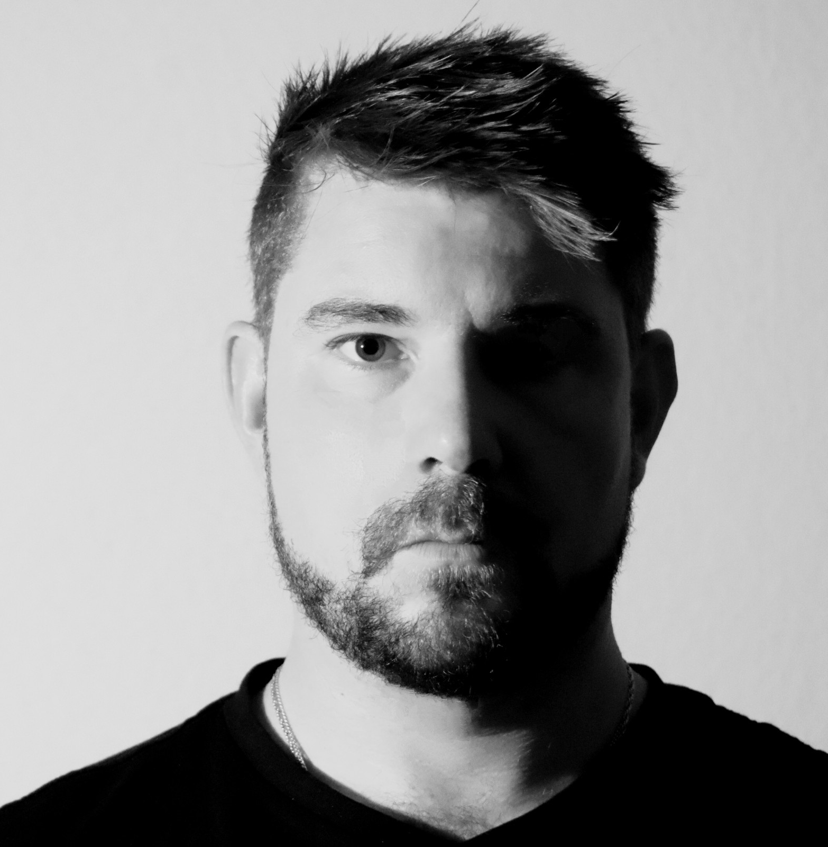


Reach out
Claudio Wyss
Founder
+41 76 2331 007
claudio.wyss@peakx.ch

